Slide 1
After the Post-It Notes How to ensure that the service you designed is the one that gets delivered
Simonking@live.co.uk
Twitter @GRServiceDesign
LinkedIn /GreatServiceDesign
Photo by Daria Nepriakhina on Unsplash

Slide 2
2010-2012: Author receiving support from publicly funded business support services
2013: Providing publicly funded video marketing support to small businesses
2014: Marketing and promoting publicly funded business support services
2015-2018: Ensuring that publicly funded business support services were designed to meet the needs of users and were easy to access.
2019: Helping teams within North Yorkshire County Council to develop profitable services that deliver great customer experiences.

Slide 3

2010
Post-Recession Grimsby

Slide 4

Received 12 Hours of Start-Up Advice from an unqualified advisor
Encouraged to take out a loan because one was available
Registered as a business with HMRC without understanding book-keeping or self assessment
Became very anxious and confused about what I’d signed up for and was fined over £100 by HMRC for missing filing deadlines
Result: Terrified about starting up a business

Slide 5

2013
The Last Shipwright in Grimsby

Slide 6
Technical Service Design
Financial Modeling
State Aid
Audit Control
Procurement
Compliance
Due Diligence

Slide 7

Competing delivery partners leads to overbidding on outputs.
Contractual outputs then determine service delivery
When behind on outputs, it’s about delivering what’s easy, not what’s right
Photo by rawpixel on Unsplash

Slide 8

2015
Enter: Post-It
Photo by rawpixel on Unsplash

Slide 9

Service Design
Co-Creation of services
User Value Propositions
Personas
User stories
Journey mapping
Photo by rawpixel on Unsplash

Slide 10

Still goes off track
No time or funding for development
Disconnect between the bid writer and the operations team
Return to type for delivery model
The risk of innovation is all on the delivery partner
Photo by Bruno Kelzer on Unsplash

Slide 11
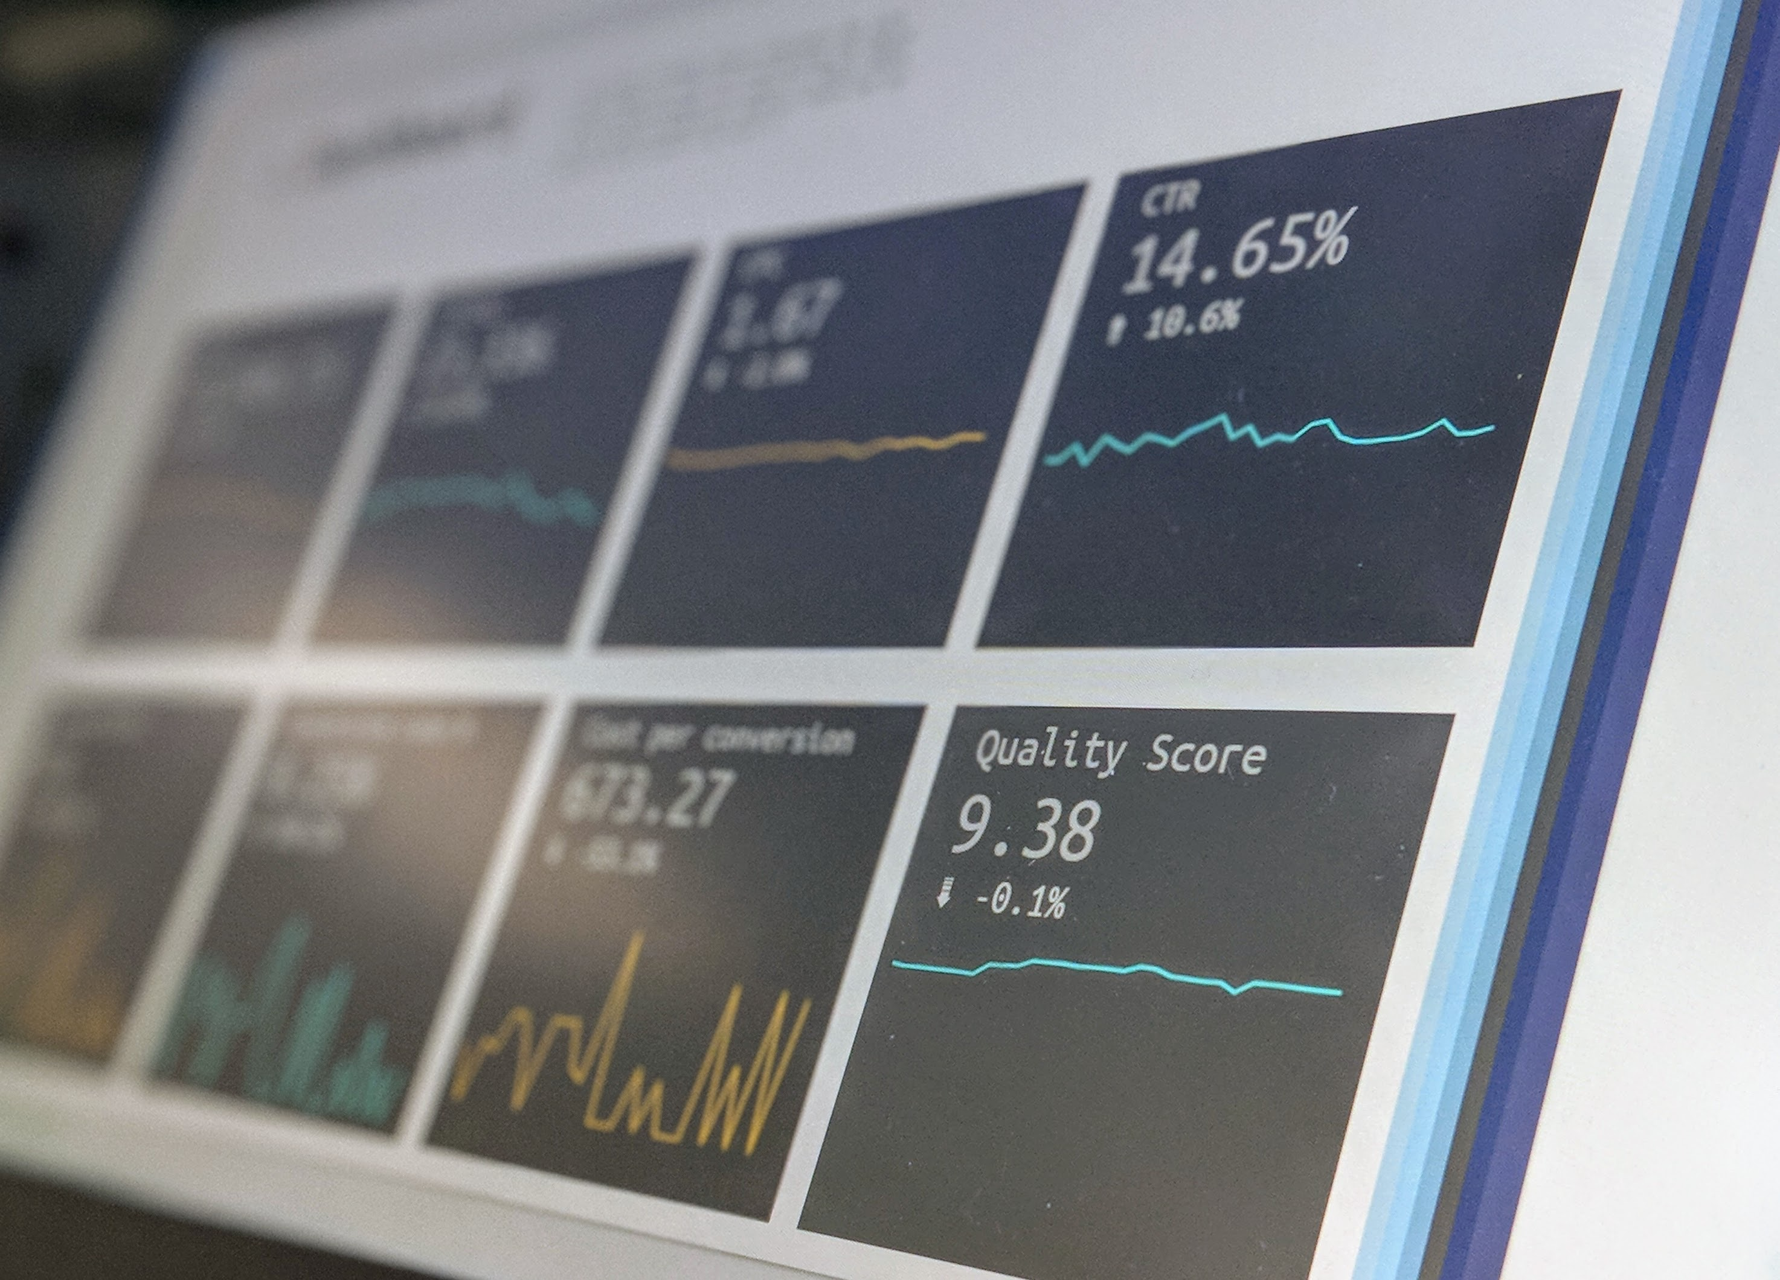
2017
Moving beyond design
Photo by Stephen Dawson on Unsplash

Slide 12
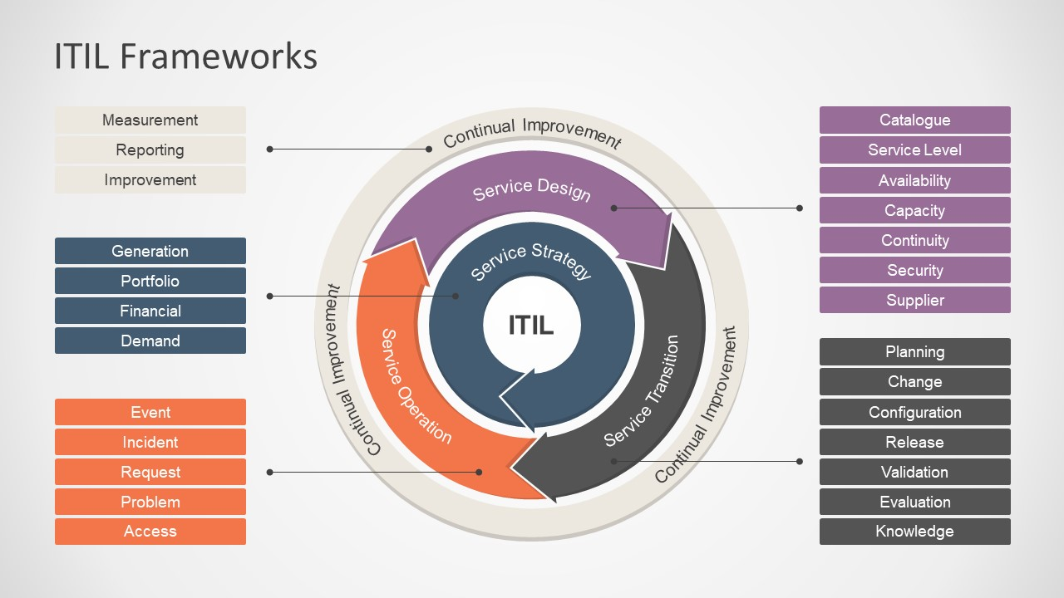
Photo by slidemodel.com

Slide 13
Key components borrowed from ITIL
Capacity forecasting
Demand forecasting
Service Design Pack to move services from design, to development, through to operations

Slide 14
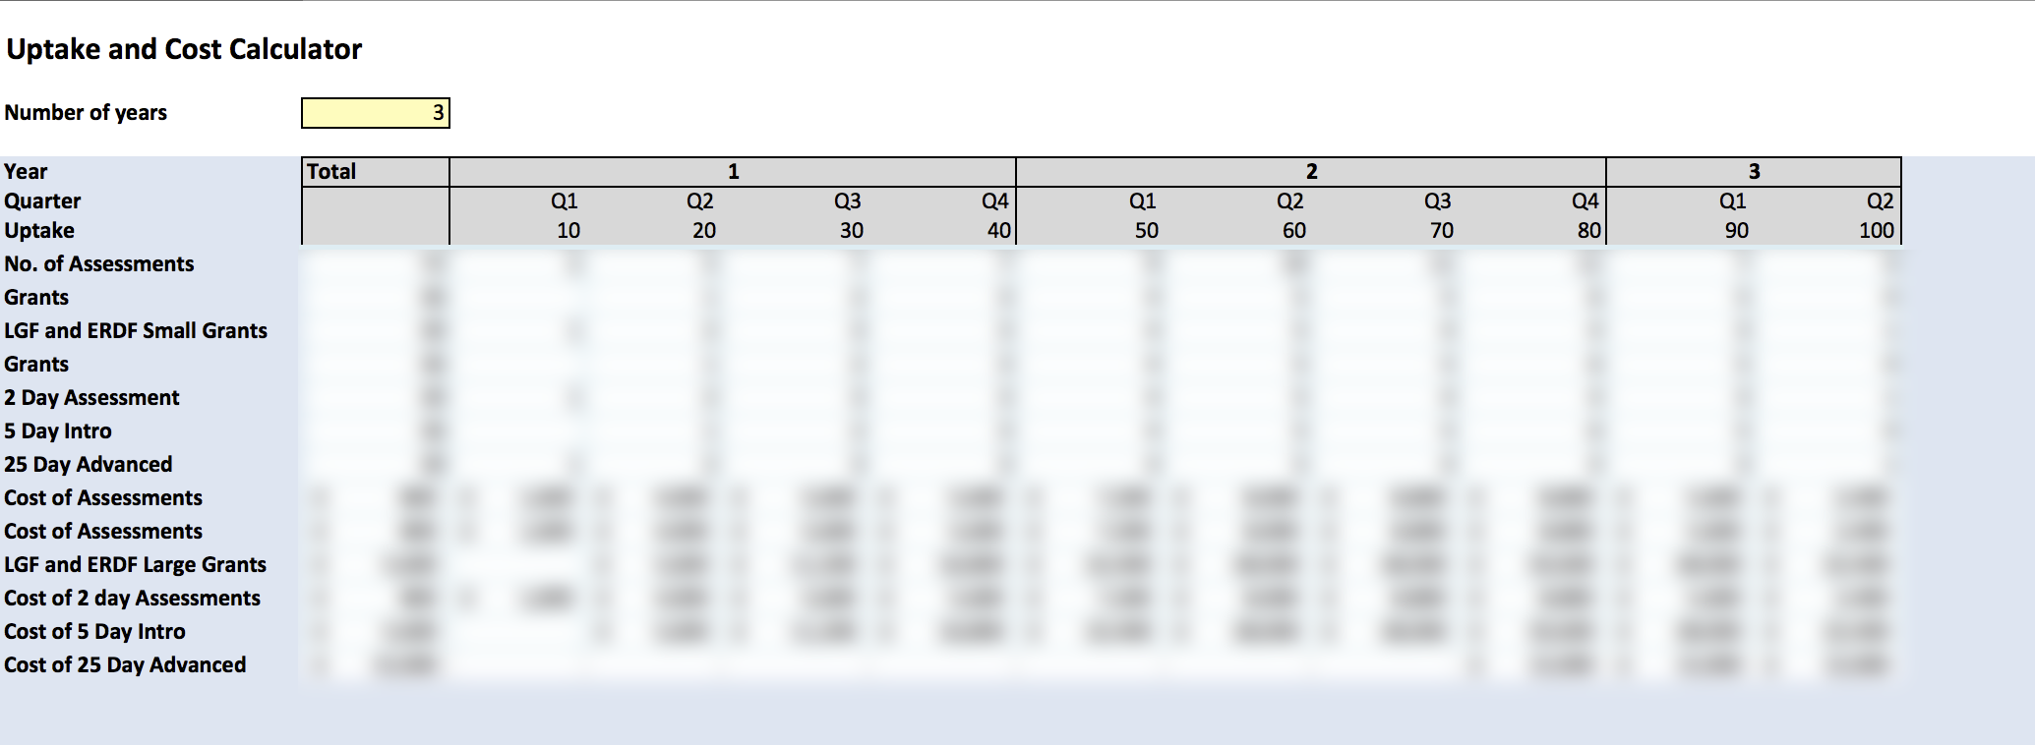
Capacity Forecasting

Slide 15
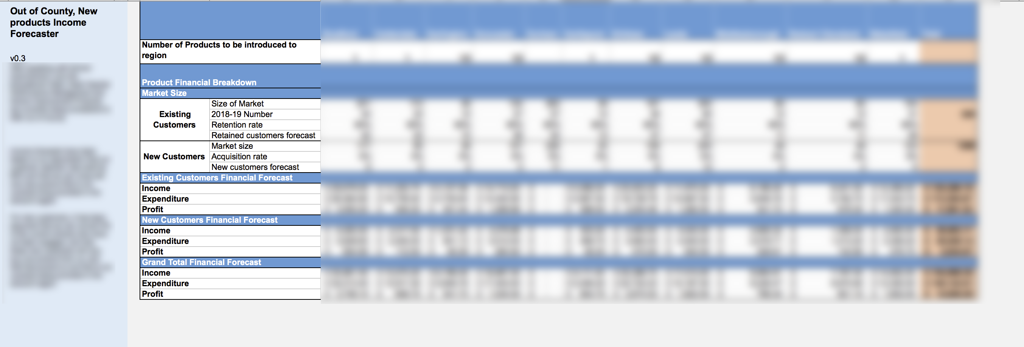
Demand Forecasting

Slide 16
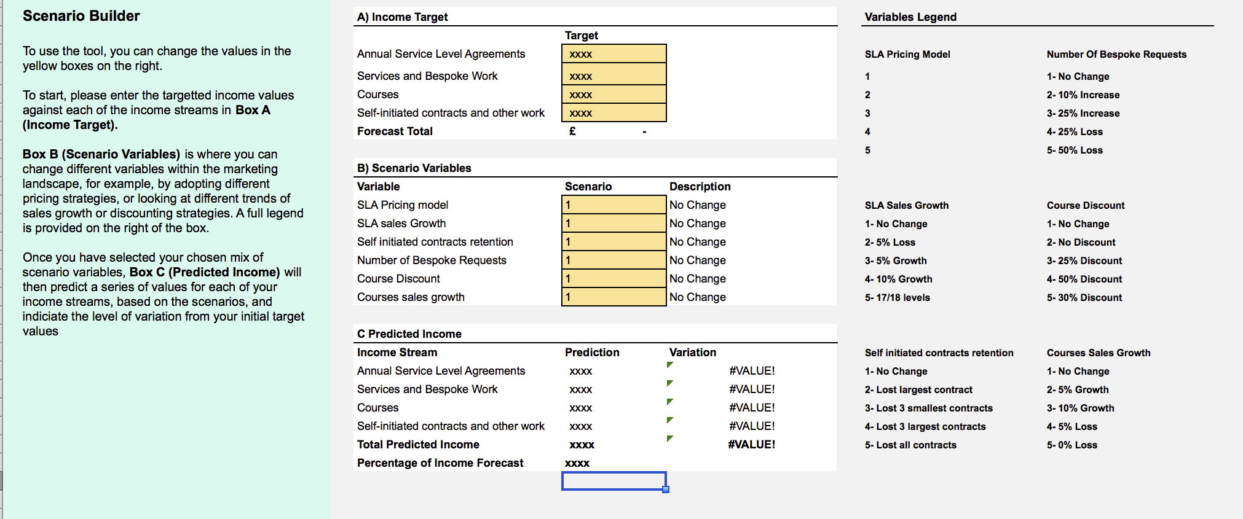
Scenario ModellingForecasting

Slide 17
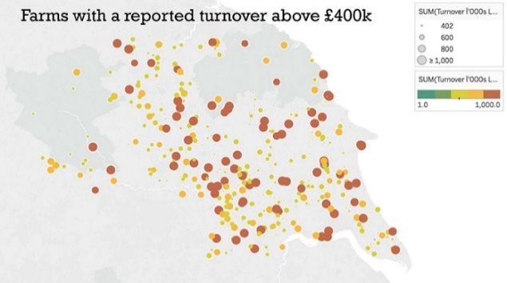
Service Design Packs

Slide 18
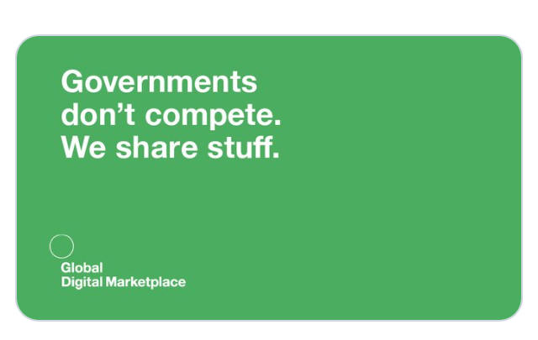
Photo by Government Digital Services

Slide 19

2019
Empowering Others

Slide 20
This is my story which I have told you. If it be sweet, tell it to someone again and then some of the thanks will come back to me.
Simonking@live.co.uk
Twitter @GRServiceDesign
LinkedIn /GreatServiceDesign

